Slide 1

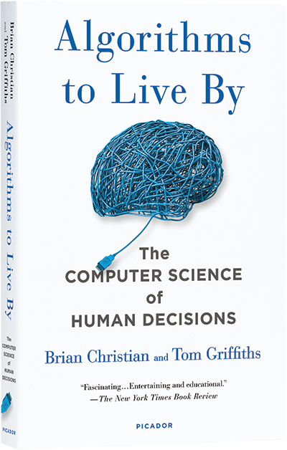
Algorithms to Live By
San Diego Machine Learning
May 1, 2021

Slide 2
How to Participate
One discussion leader, everyone welcome to participate
Ask questions
Share what you thought was interesting
How can this be applied?
Where do we see this in machine learning?

Slide 3
Introduction
Computer scientists have been addressing problems that are analogous to human decisions
E.g. when should the processor switch between its tasks
An “algorithm” is a finite sequence of steps used to solve a problem
Algorithms are used to solve math problems, in following a cookbook recipe, or in knitting according to a pattern
This book provides a vocabulary and discusses big challenges faced by computers and humans alike: dealing with finite space, finite time, and lots of unknowns

Slide 4
Optimal Stopping
The optimal solution to the “secretary problem” is to stop searching after spending 37% of your time, then choose the first person that’s the best you’ve seen
The full information version increases chance of picking the very best from 37% to 58%
Optimal stopping when looking for a parking spot depends on the occupancy rate
Research shows people usually stop too early
But also need to factor in the time cost

Slide 5
Sorting
For sorting, scale hurts
Big-O notation captures impact of scale
Simple sorts are quadratic; some are linearithmic O(nlogn)
Bucket sort doesn’t sort within buckets, is O(mn) or O(n)
Sports tournaments pick a winner, don’t fully sort
Assigning cardinal number scores allows O(1)
“Sort Is Prophylaxis for Search”
Sorting email is a waste when searching is so fast

Slide 6
https://levelup.gitconnected.com/an-intro-to-sorting-algorithms-40188ec1af2a

Slide 7
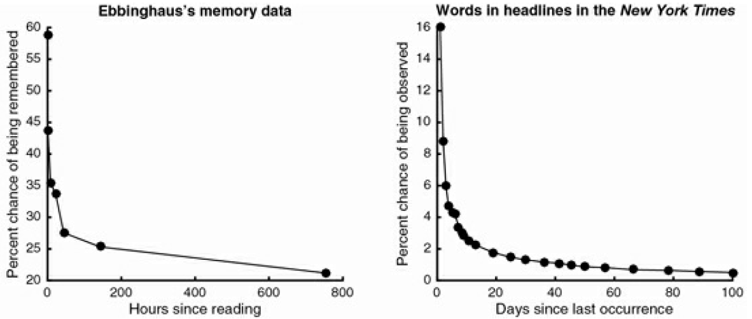
Caching
Computers use a hierarchy of memories, going from smaller and faster to larger and slower
Least Recently Used (LRU) is used for cache eviction
You can use LRU for your clothes or your files
Aging and cognitive decline may be due to amount of data

Slide 8
Scheduling
For single-machine scheduling, one must define the goal
Based on the metric chosen, there are algorithms like Earliest Due, Shortest Processing Time, or weighted importance per time
Priority inversion happened to Mars Pathfinder
It was solved by priority inheritance
Constraints and other changes make most scheduling problems intractable
Preemption helps make scheduling tractable
But beware the cost of context switches can lead to thrashing
Interrupt coalescing can help avoid thrashing

Slide 9
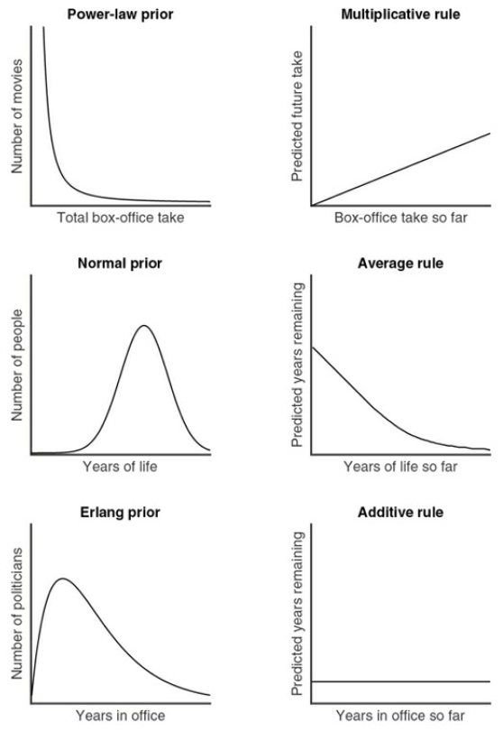
Bayes’s Rule
This chapter examines how Bayes’s Rule can be used to predict how much longer something will last
For this situation, the shape of the distribution affects the prediction made
Uninformative priors lead to the Copernican Principle
Power-law dist. example is city sizes
Normal dist. example is women’s height
Erlang dist. example is roulette wheel

Slide 10
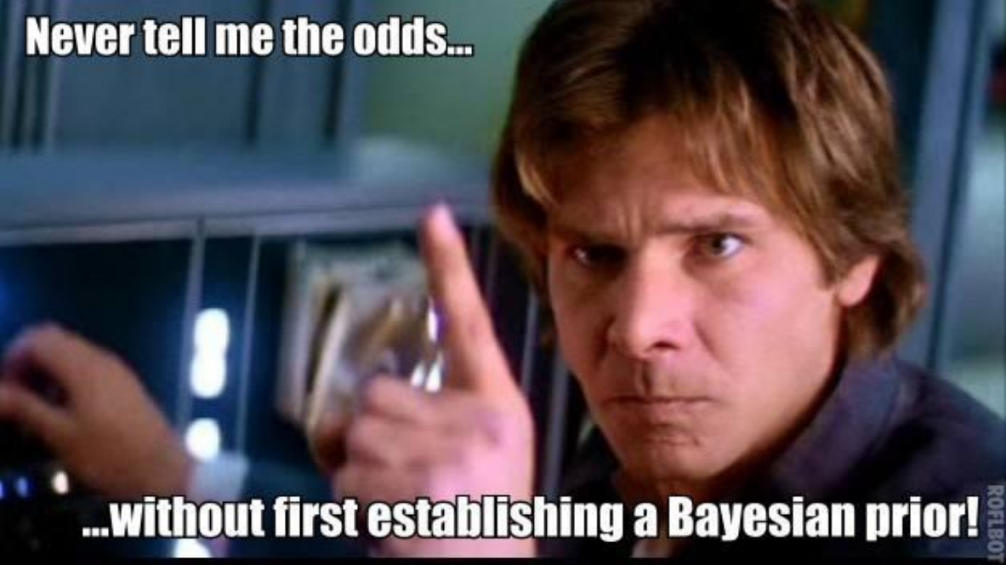
Bayes’s Rule
Good predictions require good priors
In society, this could mean protecting yourself from biased news
Bayes’s Rule and the need for good priors shows up in many ways with respect to training ML models

Slide 11
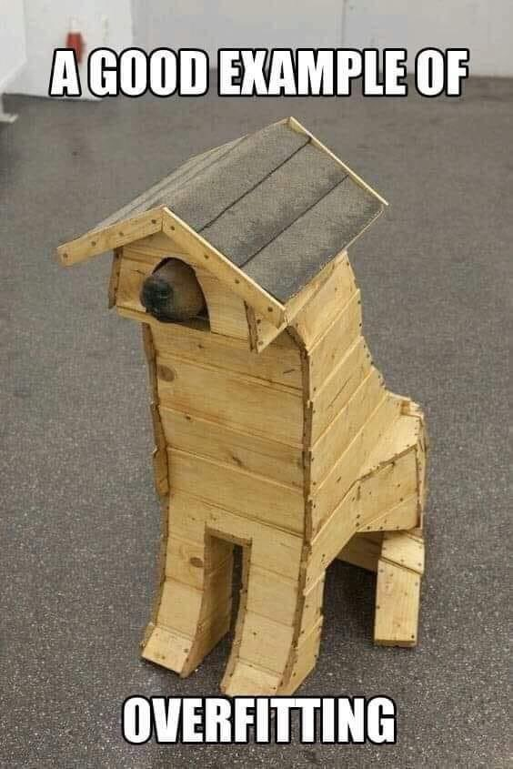
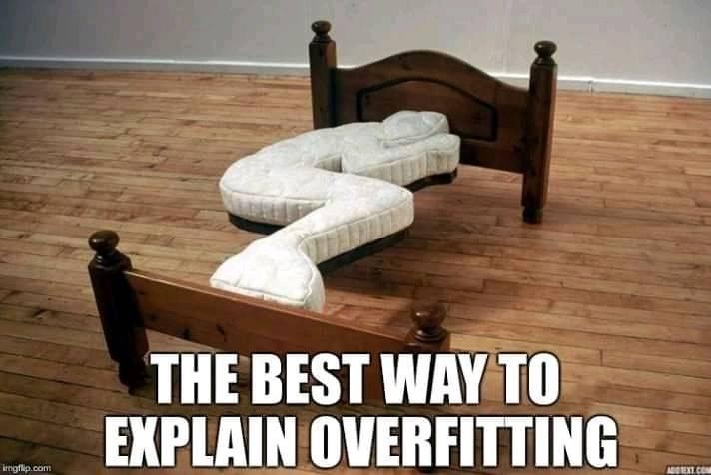
Overfitting

Slide 12
Overfitting
“Once you know about overfitting, you see it everywhere”
Eating what tastes good
Incentives will be overfit
Police picking up shell casings
Website focusing on counting page views
Cross-validation can identify overfitting
You can use less data to fit, having a holdout validation set
Or use an alternate metric to double-check (a small subset)

Slide 13
Overfitting
Regularization penalizes complexity
Heuristics reduce complexity, and can be better with uncertainty
Thinking about evolution:
“As a species, being constrained by the past makes us less perfectly adjusted to the present we know but helps keep us robust for the future we don’t.”
Early stopping is a form of regularization
In the face of high uncertainty and limited data, don’t take so long to make decisions

Slide 14
Relaxation
The traveling salesman problem is hard, with n! choices
It’s believed to be an intractable problem that cannot be solved in polynomial time
Constraint relaxation allows solutions to easier versions
E.g. minimum spanning tree for traveling salesman
Continuous relaxation allows fractional values even if nonsensical
E.g. fractional numbers of firetrucks places around the city
Lagrangian relaxation uses penalties instead of rules
E.g. sports scheduling

Slide 15
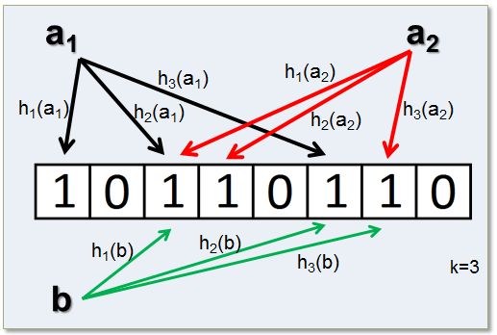
Randomness
Monte Carlo method uses sample simulations
Miller-Rabin primality test
Very fast, and can be repeated as many times as desired
Bloom filter
Set 1’s for hash of each key
Uses multiple hashes per key
If lookup sees any 0’s, then the key definitely doesn’t exist
If all 1’s, key probably exists
The more hashes, more certainty
https://redislabs.com/blog/rebloom-bloom-filter-datatype-redis/

Slide 16
Randomness
Hill climbing – a greedy incremental improvement process
May get stuck in a local maximum
Jitter, random restarts, and occasional worsening (Metropolis algorithm) can improve hill climbing results
Simulated annealing
Start high temperature – very random
Gradually cool the system down – less and less randomness
Randomness is used in training many ML models
Augmentations in an image classifier
Random crops in contrastive learning
Denoising or variational autoencoders

Slide 17
Networking
The rules in network protocols are algorithms too
Acknowledgements with counters are critical to TCP
Exponential backoff
Author calls it the algorithm of forgiveness because it never completely gives up
Additive Increase Multiplicative Decrease flow control
Bufferbloat
Perhaps we should pay more attention to latency over throughput

Slide 18
Game Theory
Nash equilibrium
Tragedy of the Commons
Comes from the equilibrium can be rational and best for each individual, but bad for everyone, just like the prisoner’s dilemma
E.g. employees wanting to take less vacation than their peers
Mechanism design
Possible to shift the equilibrium, even by worsening every outcome
Information cascades and bubbles
Vickrey auction – rules incentivize honesty

Slide 19
Explore/Exploit
Multi-armed bandit
E.g. try new restaurant or go to old favorite
Win-Stay, Lose-Shift
The lose-shift action is severe, and doesn’t incorporate the interval remaining
Discounted future rewards
Gittens Index

Slide 20
Explore/Exploit
Regret
Upper confidence bound algorithms
Dan Siroker A/B testing for the Obama website
Clinical trials - static or adaptive
When we should Explore
When we should Exploit

Slide 21
Conclusion
Computational kindness
Groups choosing an activity
Parking lots in a single path away
An 18 cent coin
Also, be kind to yourself
Hard problems don’t have easy, exact solutions

Slide 22
Our next book club…

Slide 23
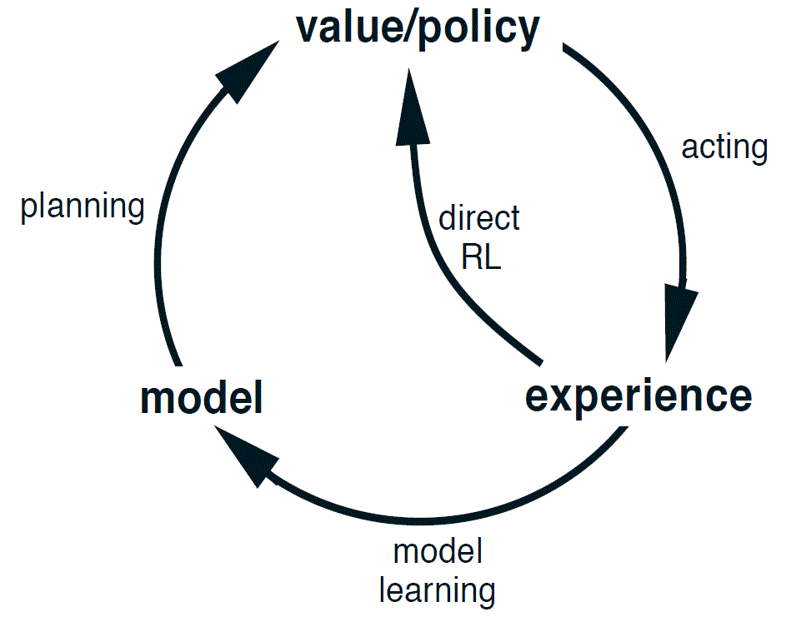
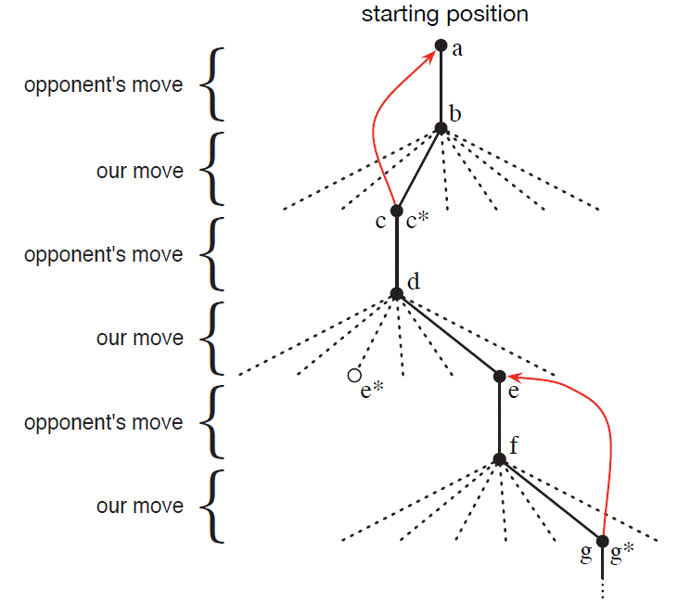
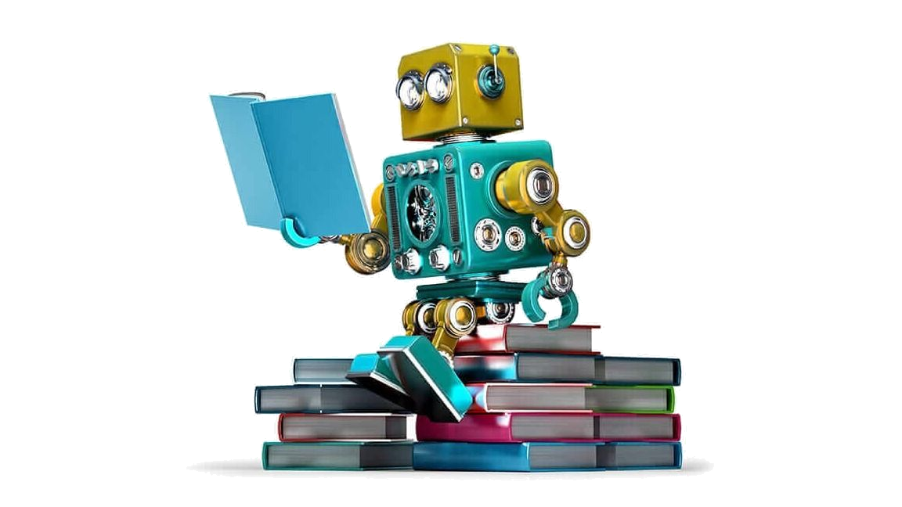
Introduction to Reinforcement Learning
Saturday, May 15, 2021
12:00 pm (PDT)
SDML Book Club
Virtual Meetup
Zoom link in Meetup info

